Slide 1
CAPSTONE - SQL
MOVIE RENTAL DATA ANALYSIS
ALFIN SAM MATHEW
ENROLL.: EN12024078062
BATCH : DA132S13

Slide 2
OBJECTIVE
To analyse the kind of movies are most often demanded.
To find the genre movies mostly demanded.
To find the list of actors appeared in mostly demanded movies.

Slide 3
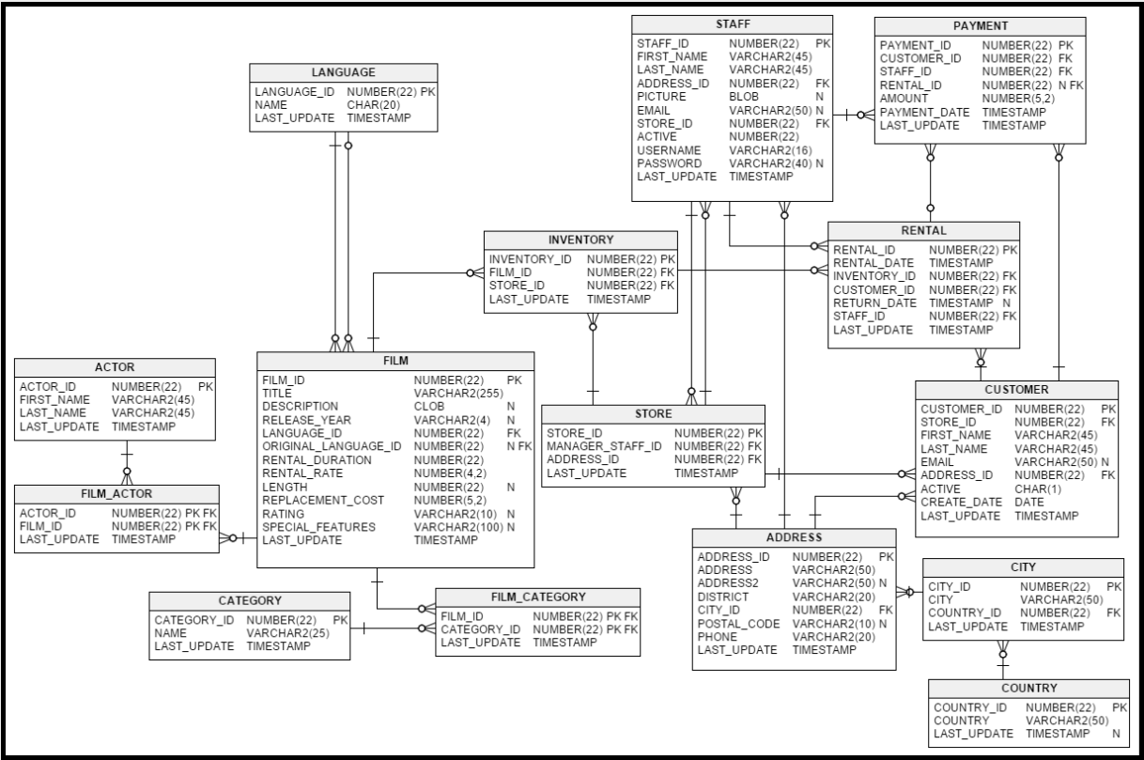
SAKILA DATABASE
The Sakila database is a nicely normalized schema modelling a DVD rental store, featuring things like films, actors, film-actor relationships, and a central inventory table that connects films, stores, and rentals.

Slide 4
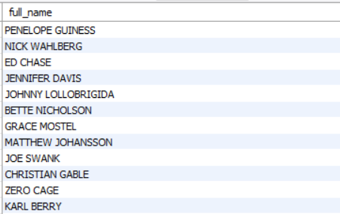
There are total of 200 actors in the given dataset.
Task 1 : Full Name of Actors

Slide 5

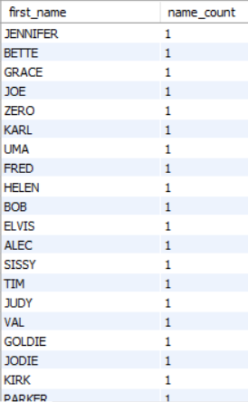

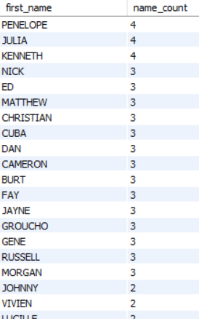
The maximum number of first name repetition is 4. There are total of 76 actors with unique first name.
Task 2: First names of the actors appeared frequently and count of unique names.

Slide 6

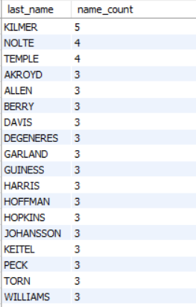

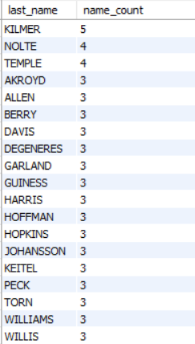
The maximum number of last name repetition is 5. There are total of 66 actors with unique first name.
Task 3: Last names of the actors appeared frequently and count of unique names.

Slide 7



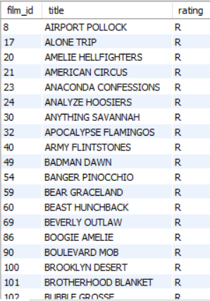
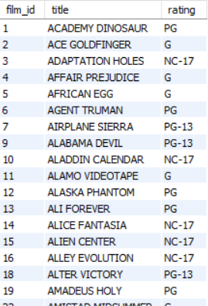
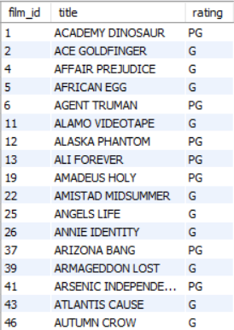
Task 4 : - List of movies with the rating R – 195 movies with R rating - Not rated R – 805 movies with R rating - Movies suitable for auidence below 13 years of age – 372 movies

Slide 8
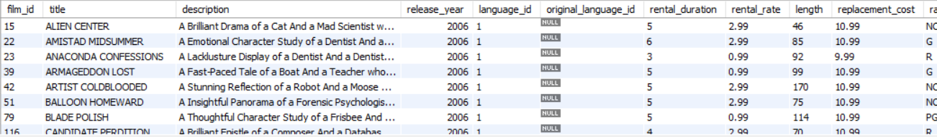
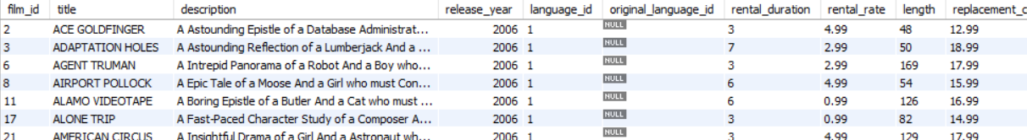
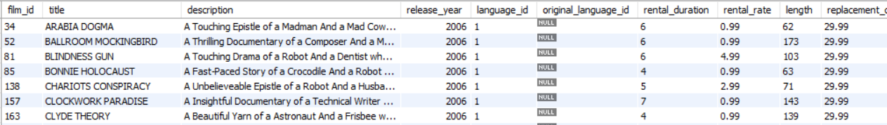
Task 5 : - List of movies where the replacement cost is up to $11
- Replacement cost is between $11 and $20
- All movies in descending order of their replacement costs

Slide 9


The movies with the greatest number of actors are : LAMBS CINCINATTI CHITTY LOCK BOONDOCK BALLROOM
Task 6 : Names of the top 3 movies with the greatest number
of actors.

Slide 10

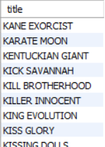
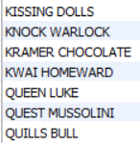
Total of 15 movies whose names are starting with K and Q.
Task 7 : Titles of the movies starting with the
letters `K` and `Q`.

Slide 11
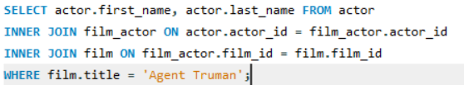
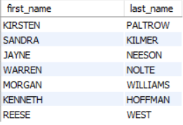
Total 7 actors are appeared in the film Agent Truman.
Task 8 : Names of all actors who appeared in
film Agent Truman.

Slide 12

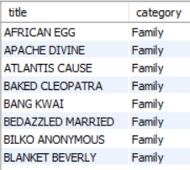
Total 7 actors are appeared in the film Agent Truman.
Task 9 : Movies categorized as family films..

Slide 13
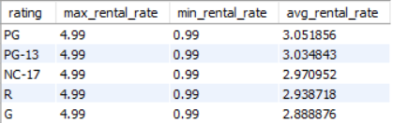
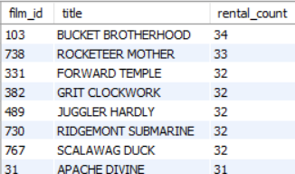
Task 10 : - maximum, minimum, and average rental rates of movies based on their ratings
- Movies in descending order of their rental frequencies

Slide 14
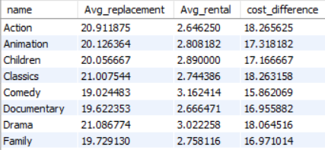
All categories have cost difference greater than $15.
Task 11 : Categories that have difference between the average film replacement cost
and the average film rental rate is greater than $15.

Slide 15


Foreign category and Sports category have more than 70 movies.
Task 12 : Film categories in which the number of movies
is greater than 70.

Slide 16
INSIGHTS :
There are total of 200 actors in the given dataset.
All categories have cost difference greater than $15.
Agent Truman is the movie most demanded.
The maximum number of last name repetition is 5.
There are total of 66 actors with unique first name.
Foreign and sports genre are most demanded.
Alfin Sam Mathew

Slide 17
THANKS!
Alfin Sam Mathew
Does anyone have any questions?

